Slide 1
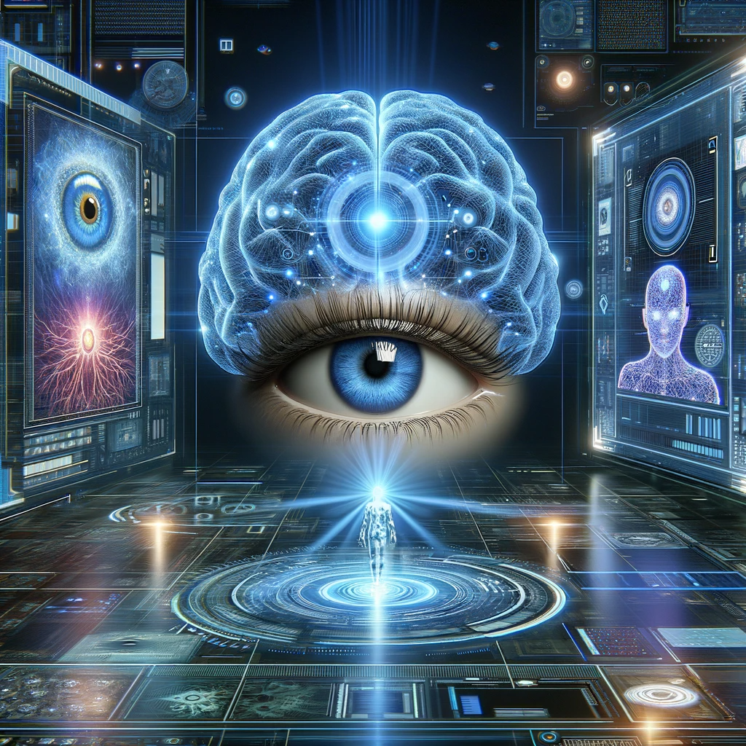
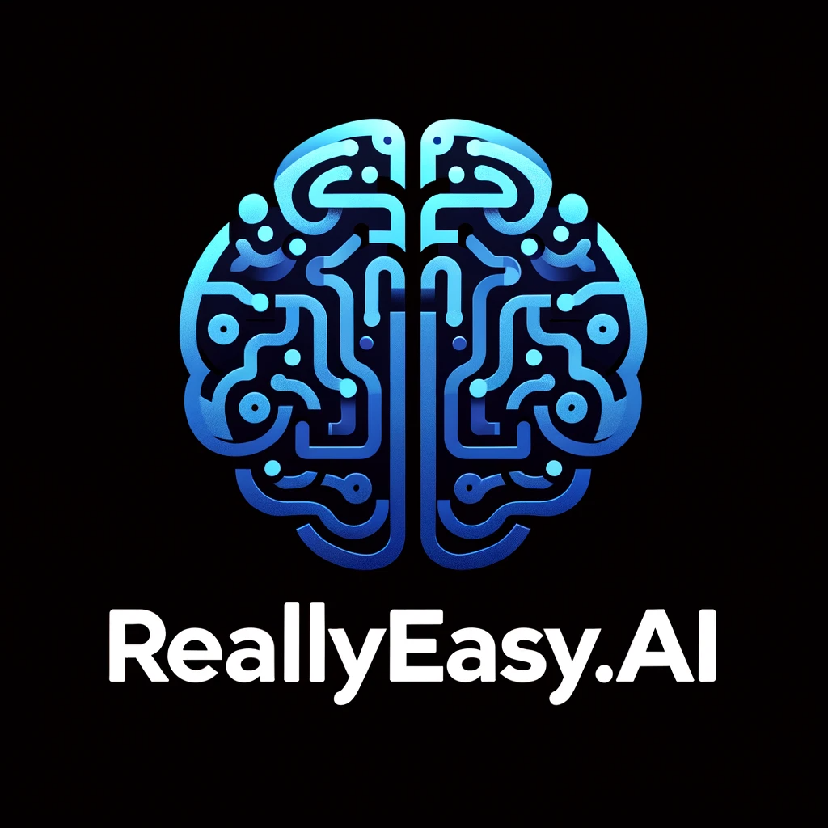
How to really use ChatGPT Plus Vision

Slide 2
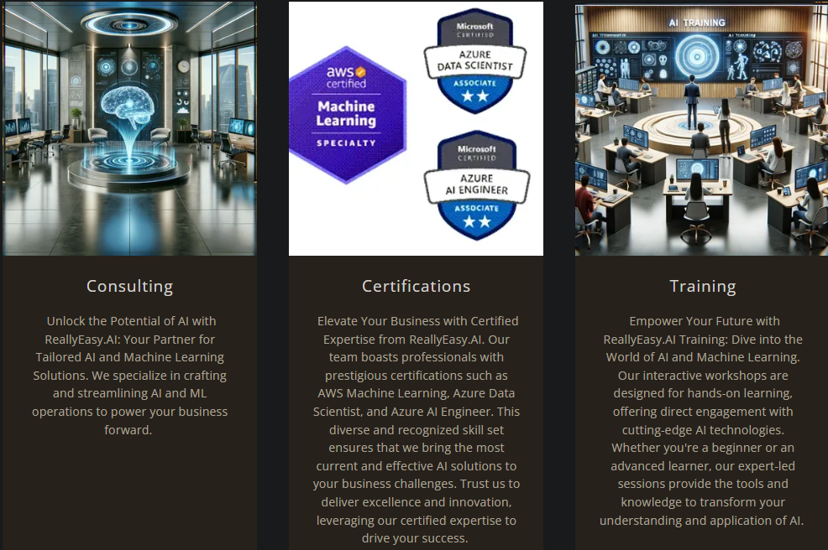

Slide 3
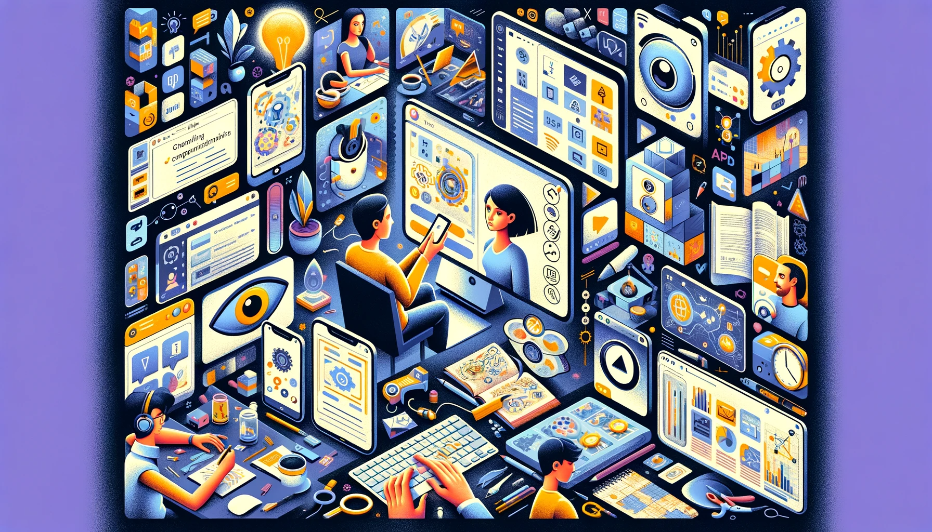
"AI is probably the most important thing humanity has ever worked on. I think of it as something more profound than electricity or fire."
- Sundar Pichai, CEO Alphabet

Slide 4
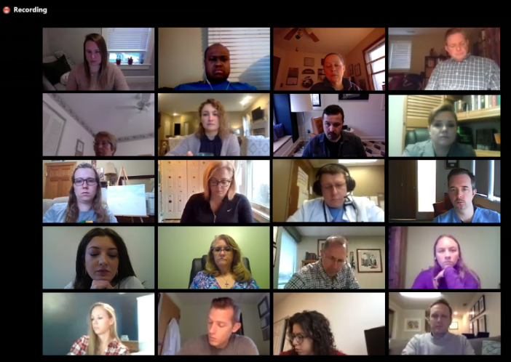
Meetings

Slide 5
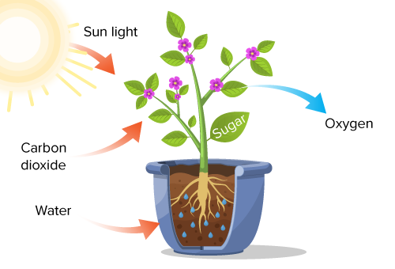
Lesson Plans

Slide 6
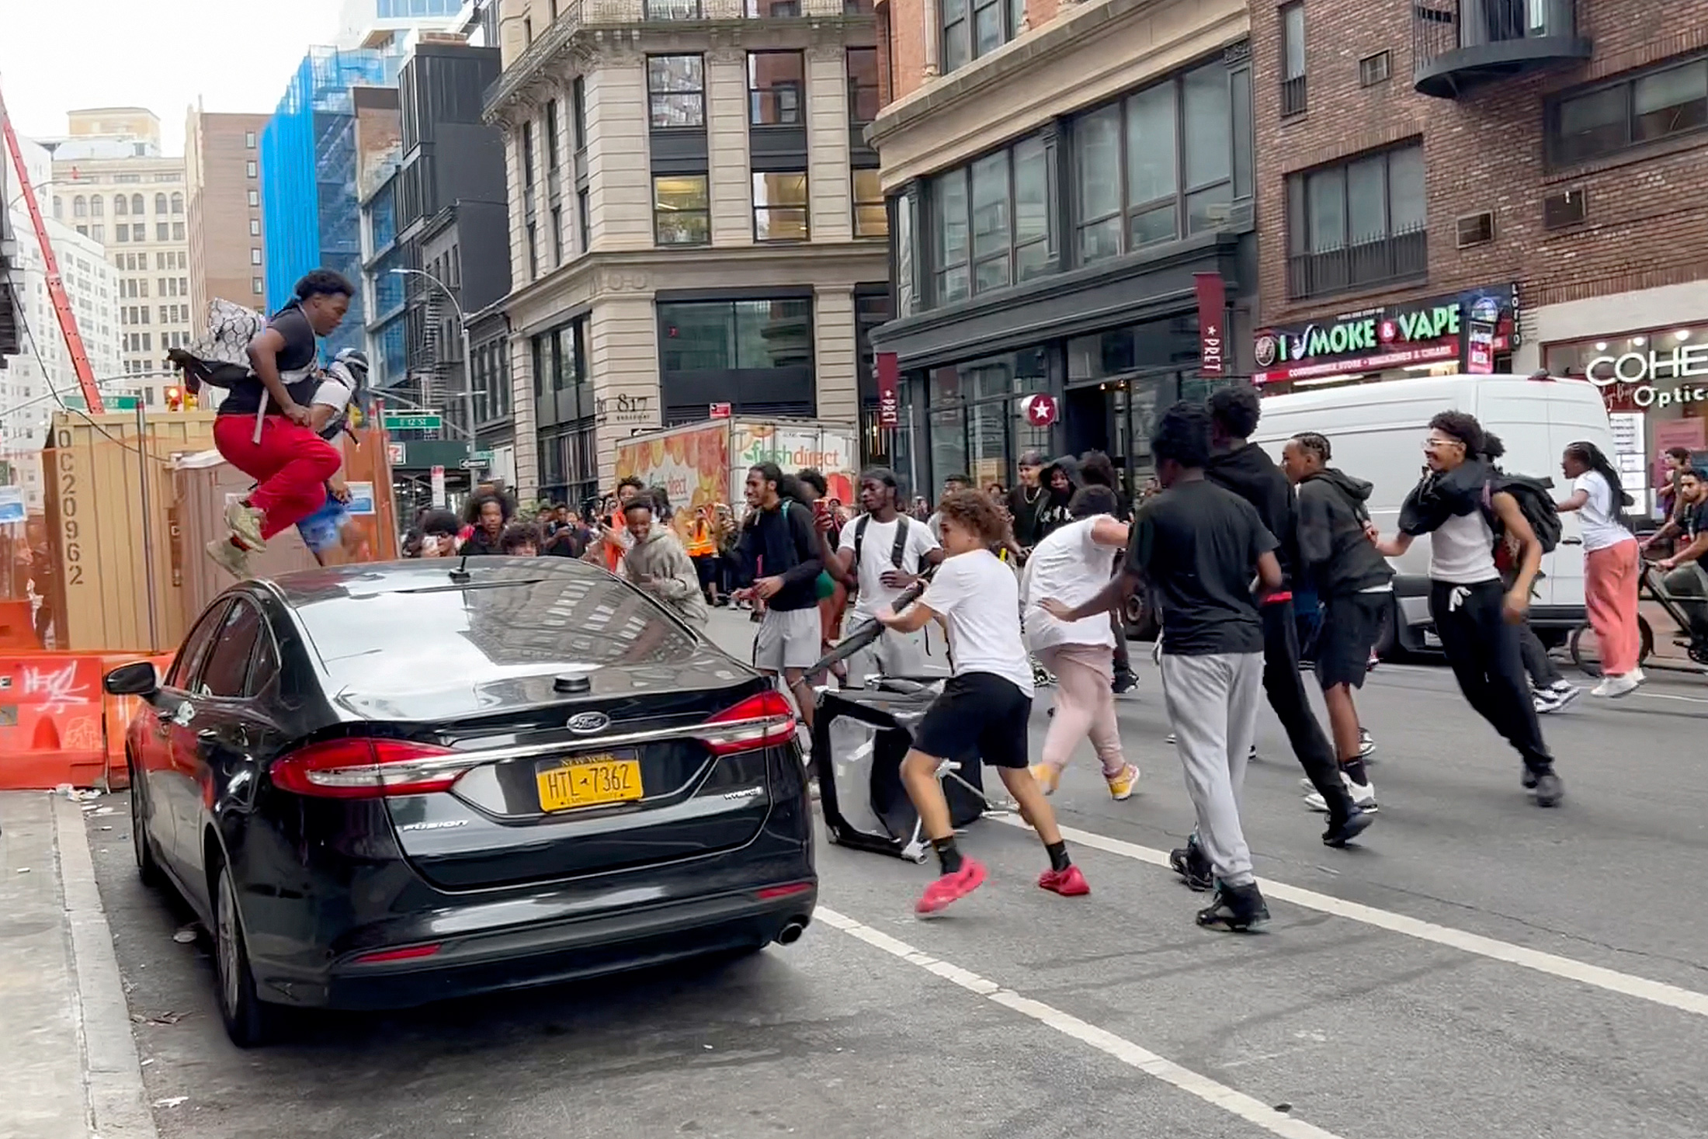
Identification

Slide 7
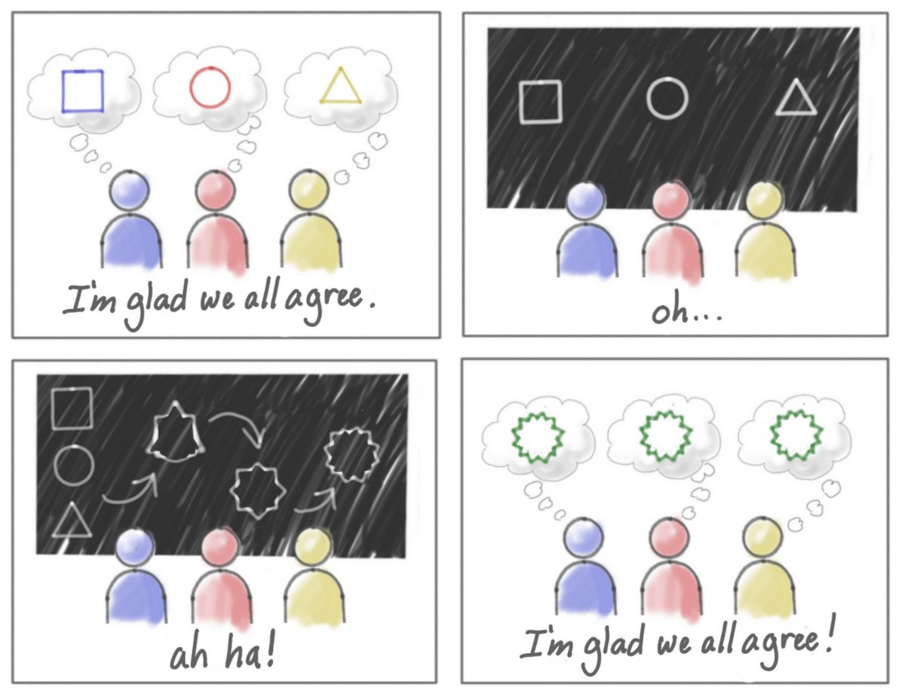
Abstract Ideas

Slide 8

Medical

Slide 9
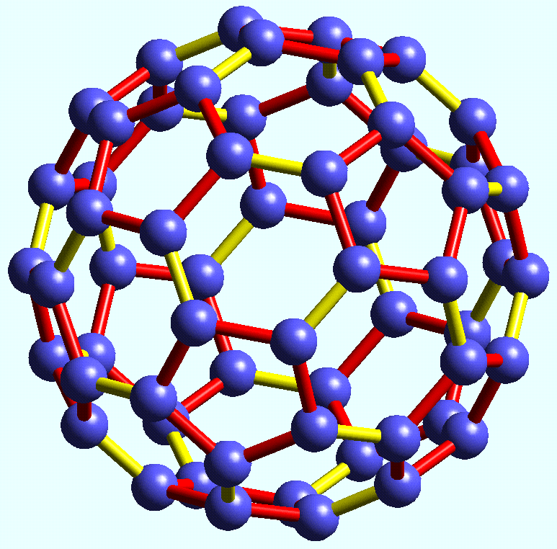
Chemistry

Slide 10
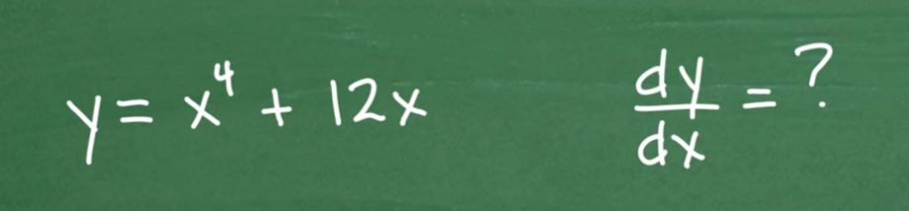
Math

Slide 11
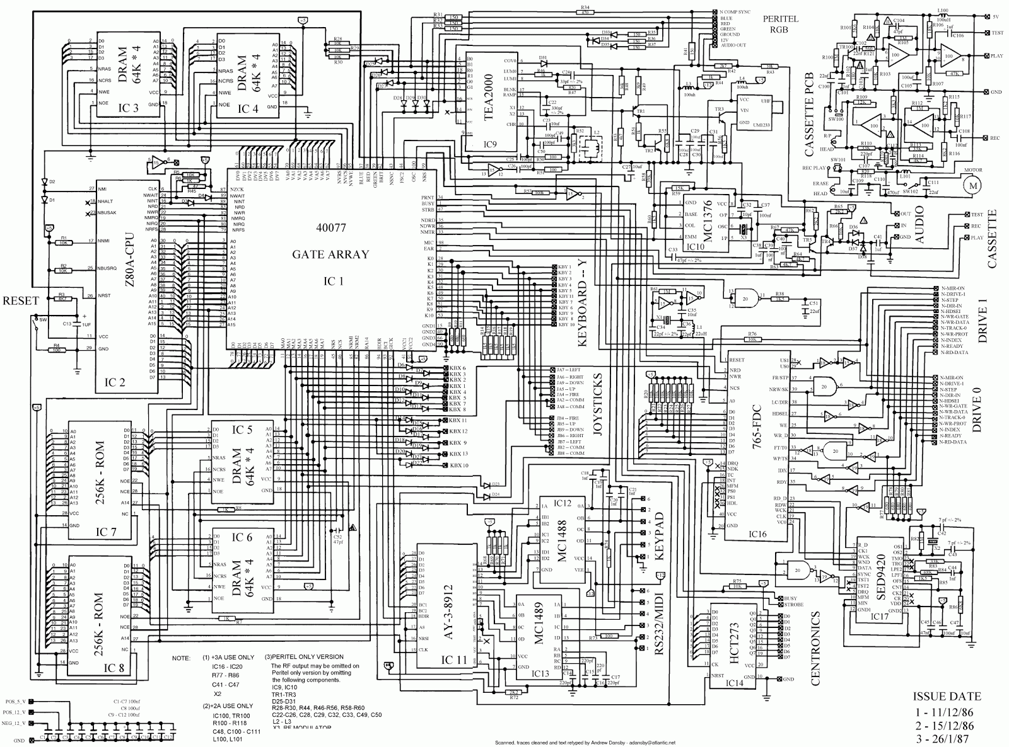
Electronics

Slide 12
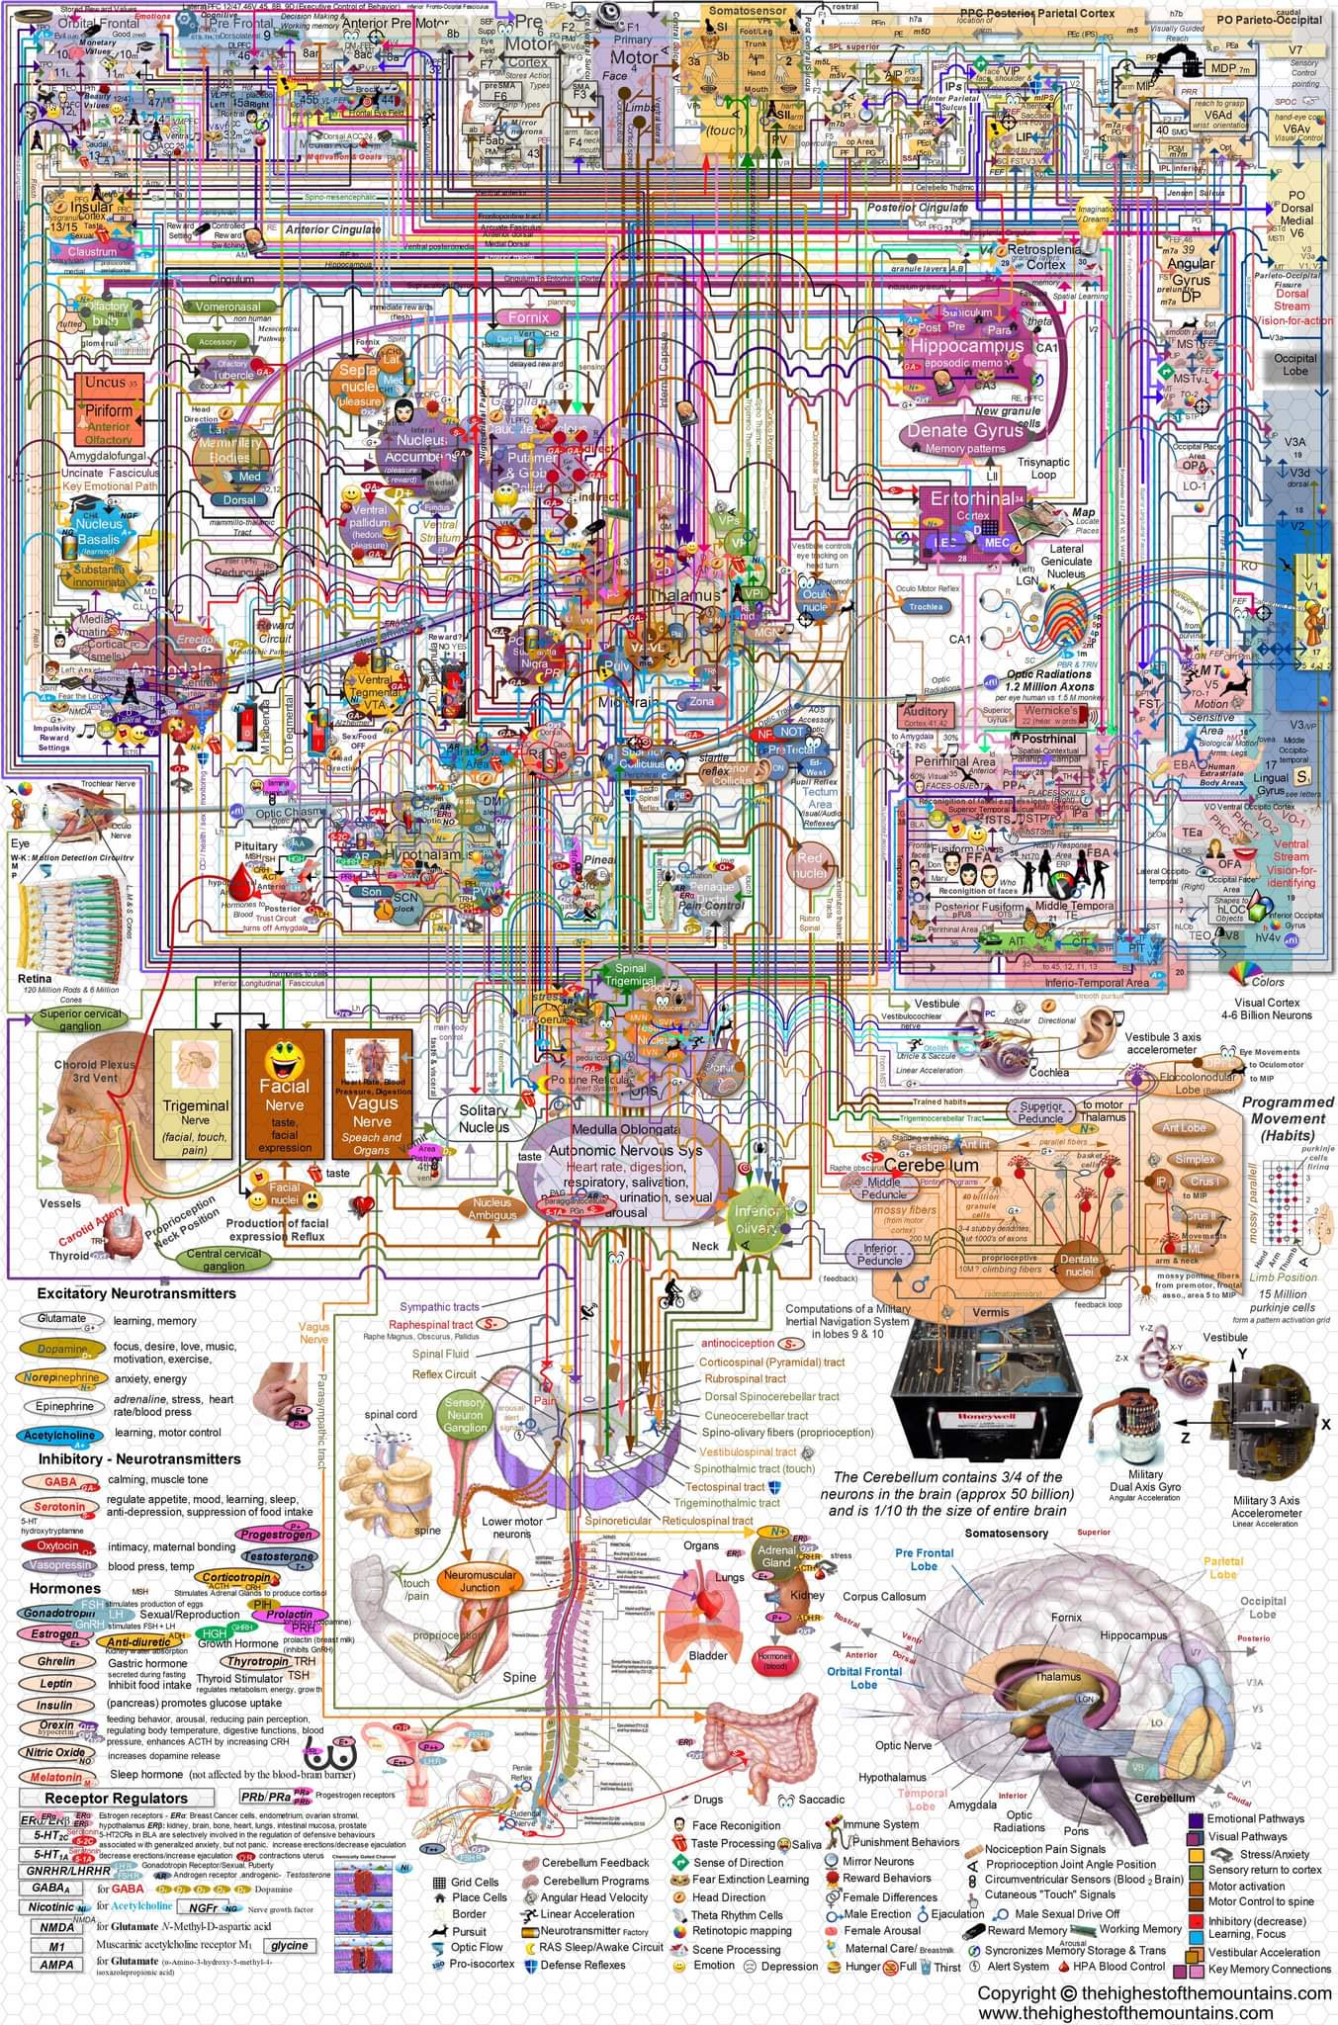
Confusing diagrams

Slide 13
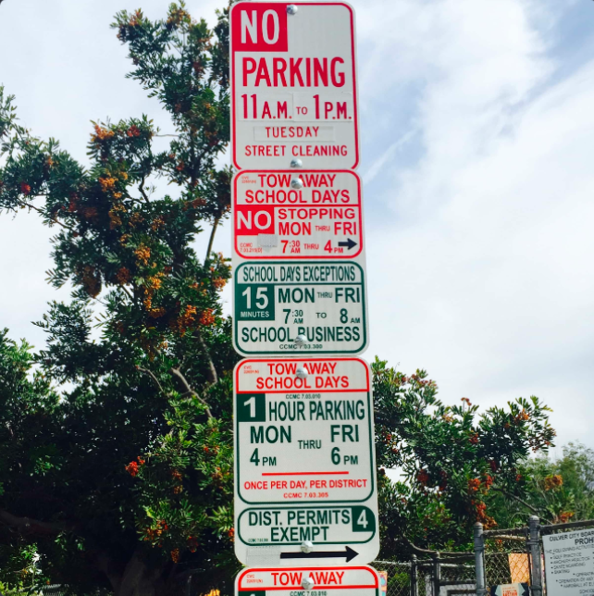
Parking

Slide 14
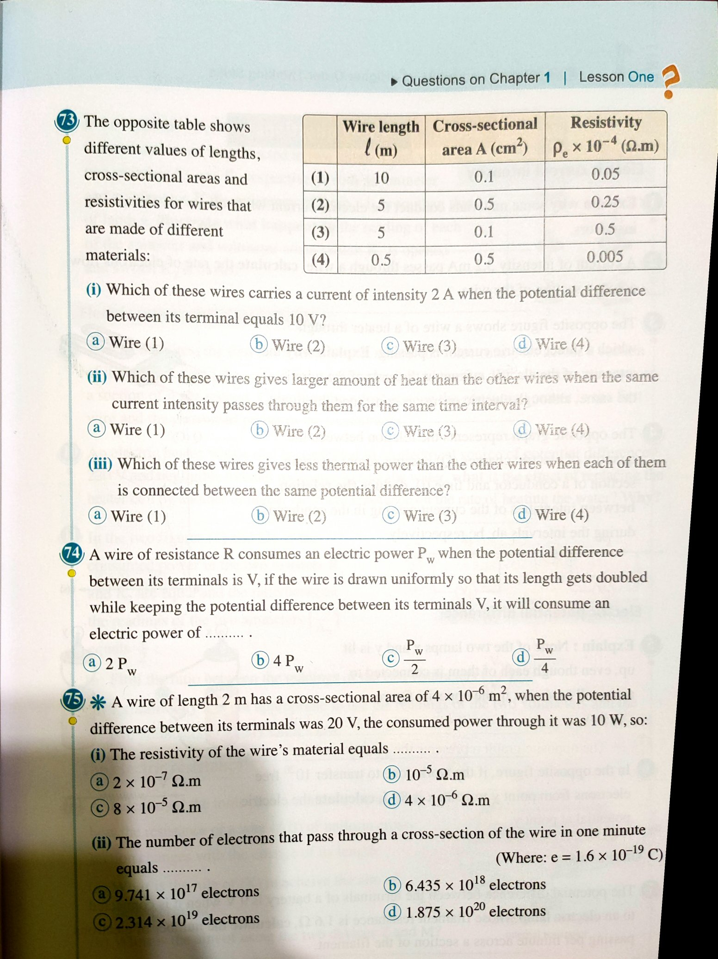
Homework

Slide 15

Cooking

Slide 16

Home Decor

Slide 17
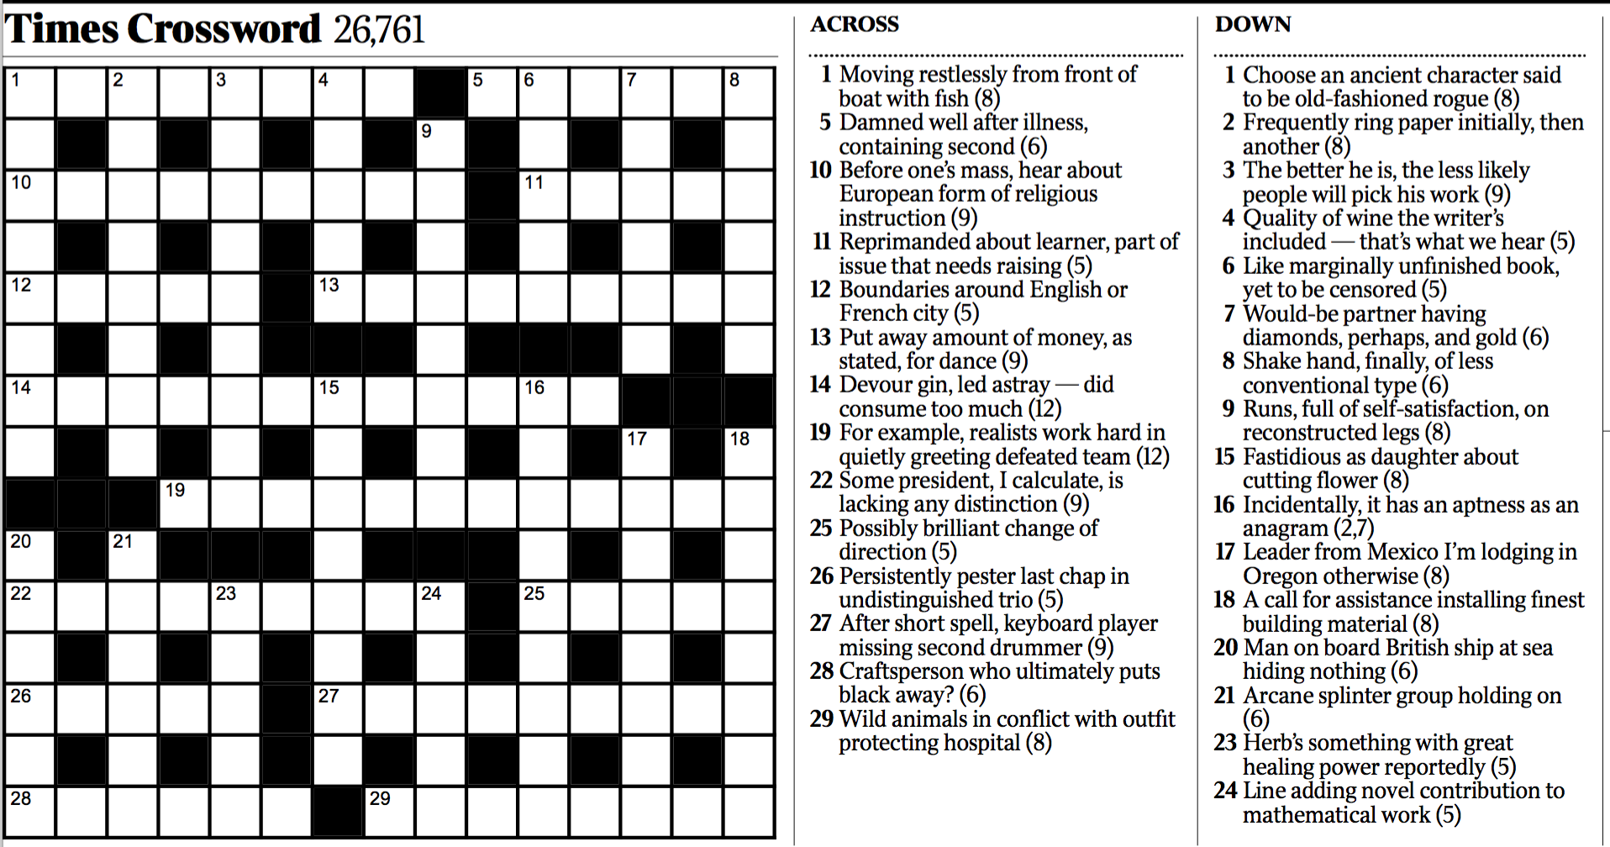
Crossword Puzzle

Slide 18
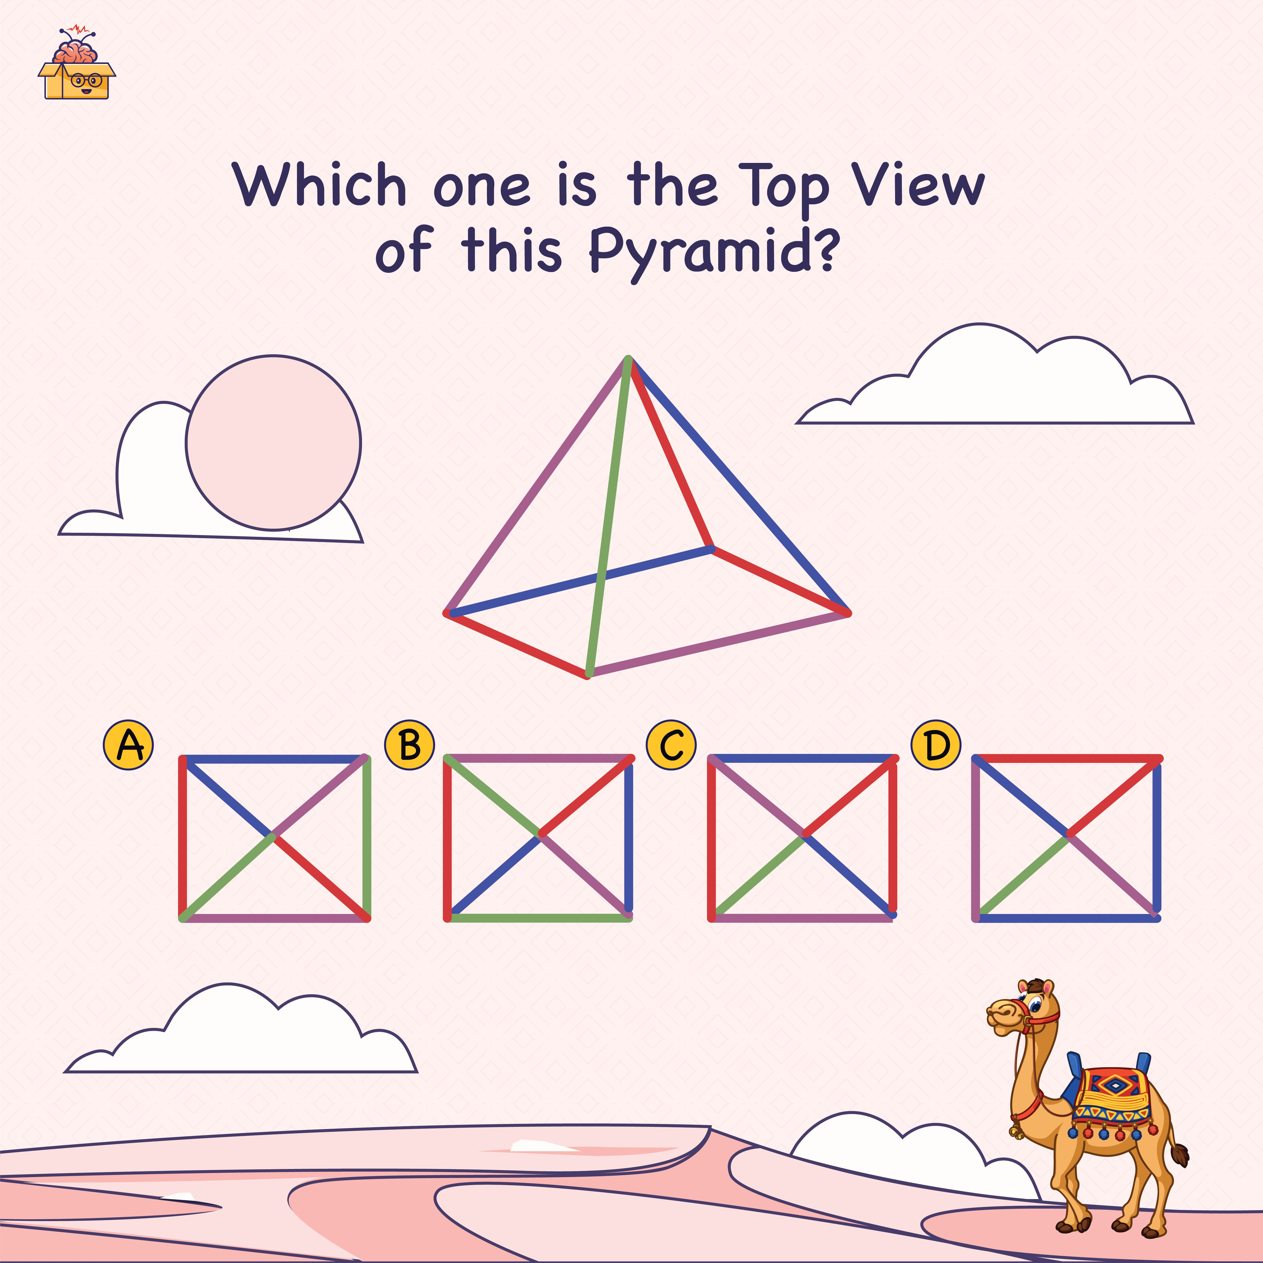
Picture puzzles

Slide 19
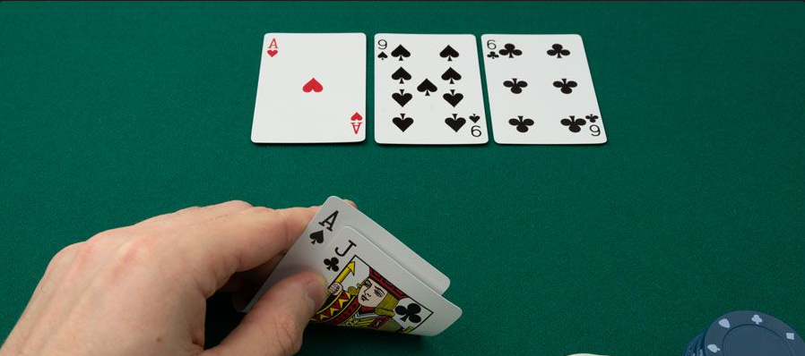
Poker

Slide 20
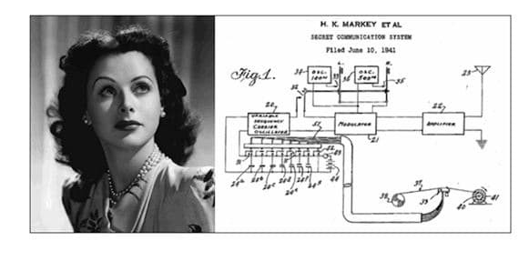
Relationships Between Images

Slide 21
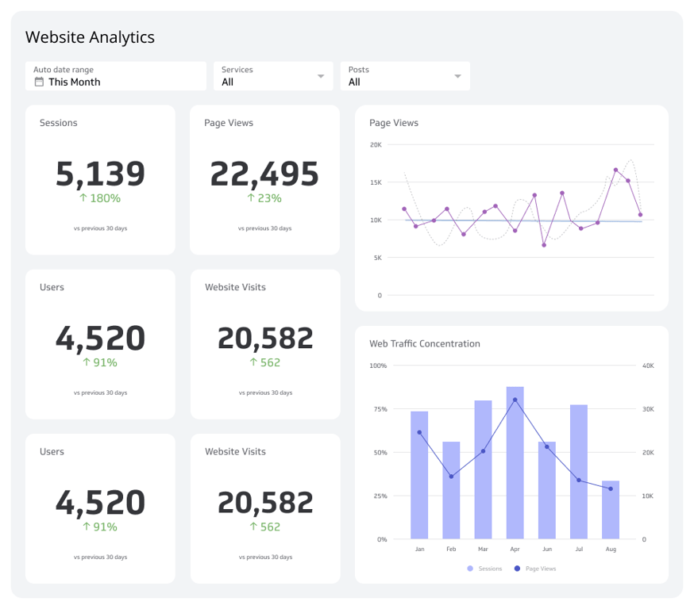
Code

Slide 22
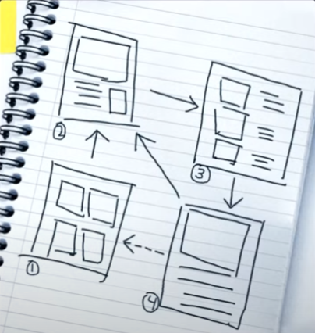
More Code

